Slide 1
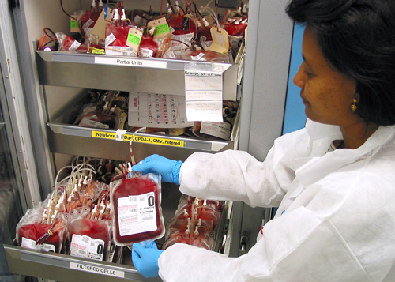
Blood Bank

Slide 2
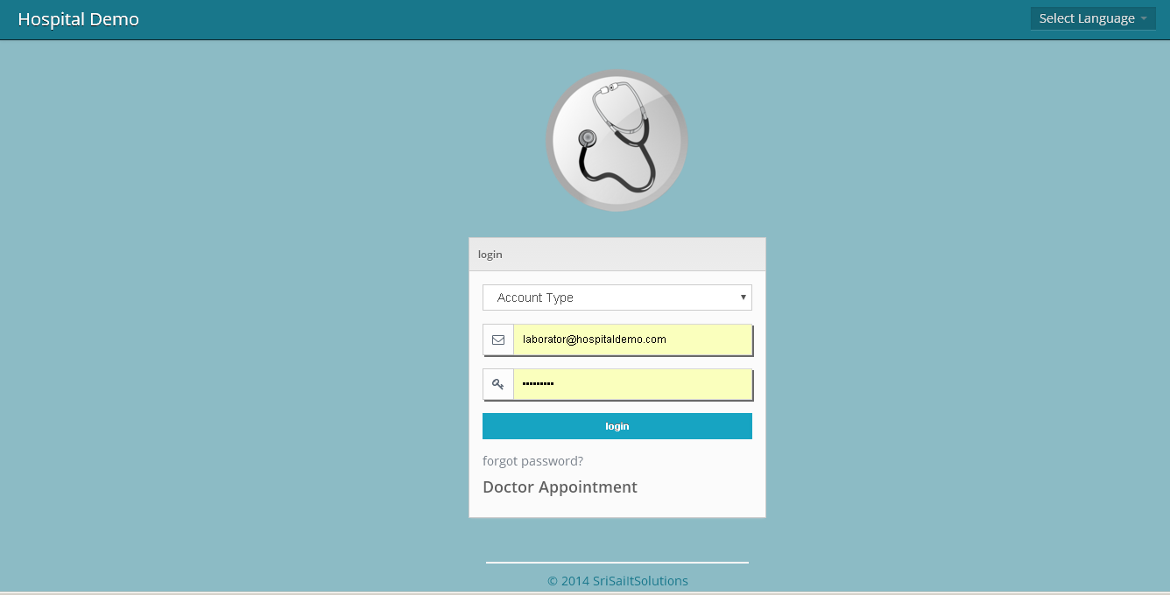
Live Demo : http://myhospitalcrm.com/hospital/
Role : laborator
id : laborator@hospitaldemo.com
Pwd : laborator

Slide 3
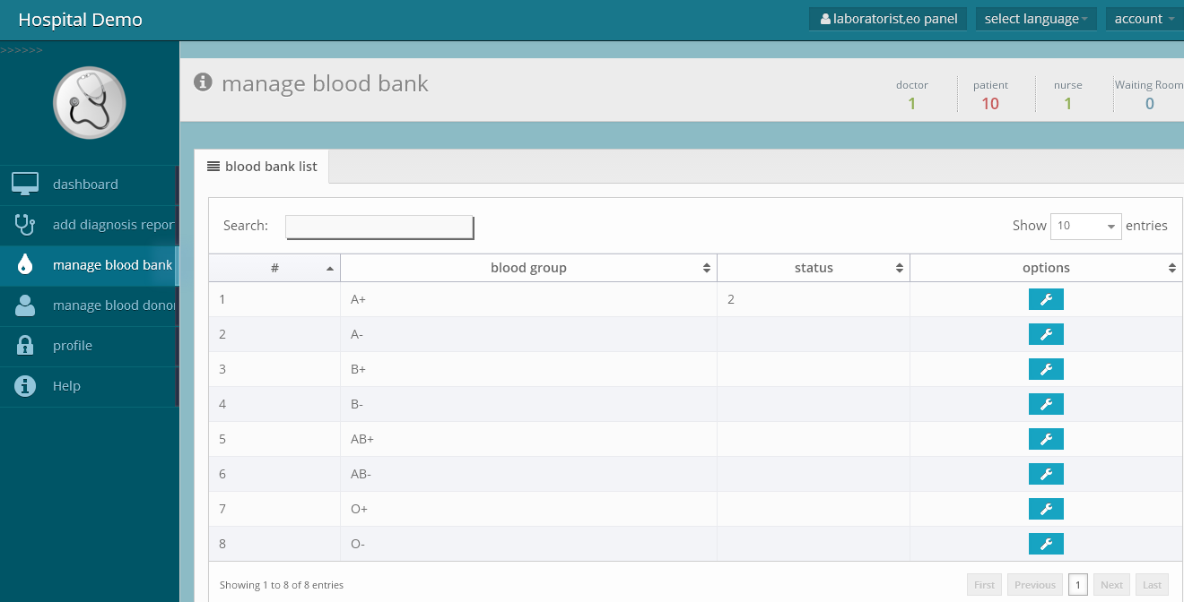
Blood Bank – Stock Report

Slide 4
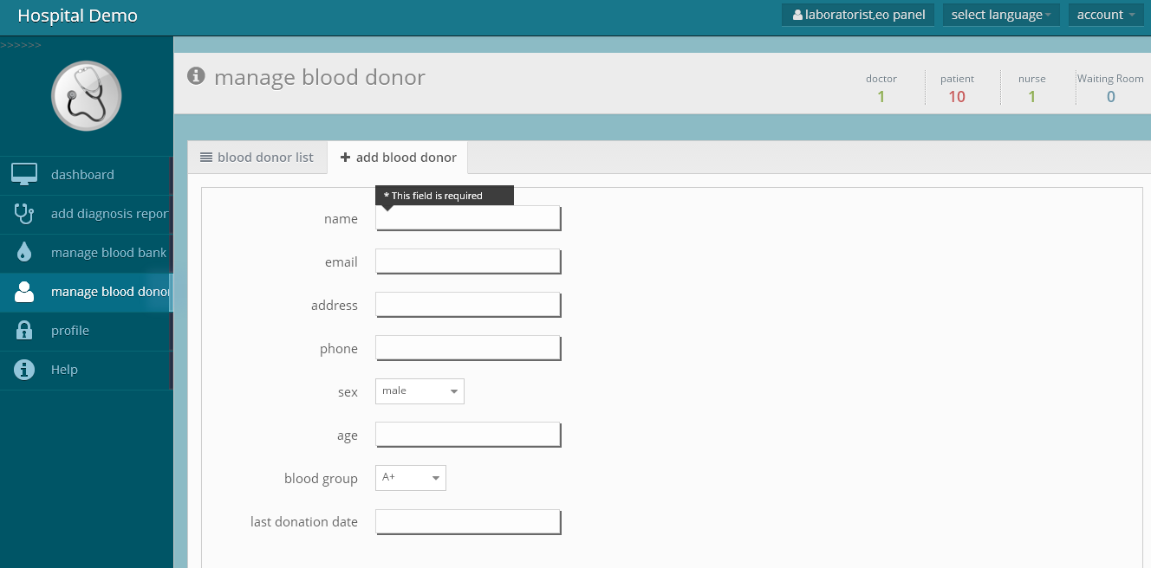

Slide 5
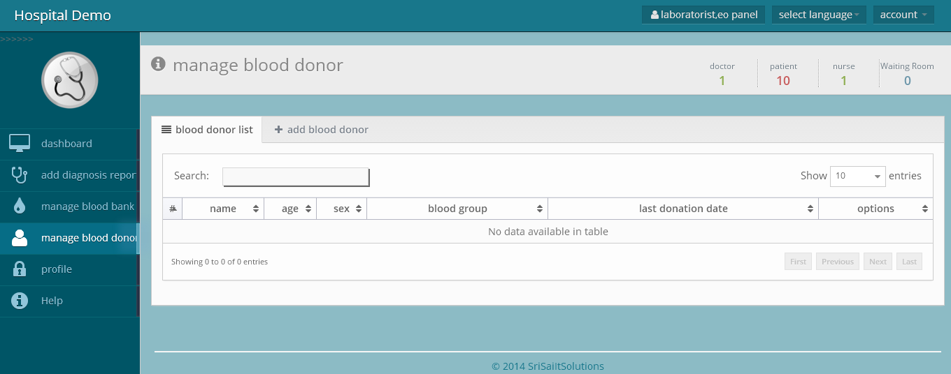

Slide 6
Contact Us
SSITS, HealthCare Soft Dev. Dept. Hyderabad
Email : sales@myhospitalcrm.com or sateeshh@gmail.com
Mobile : Satish – 8341016646 (WhatsApp) / 8341102235
Thank you

