Slide 1
Convert your School to Smart School by Using MySchoolCMS

Slide 2
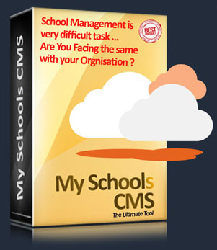
Don’t worry we help you to resolve the problem. You are just away from Click a Button for easy and smooth Management without worry, where ever you are across the globe.
Mobile / Tab / Laptop or PC
Save Time & Money
Better Utilization School Resources
Please do not hesitate to talk to our Representatives, Live Chat Support available.

Slide 4
About Us
Core Team
Why MySchools CMS ?
99 Reasons
Core Modules
ERP Slides
Pricing
Contact

Slide 5
Our History
1998
Our product is initially developed with DOS based applications, we got vast experience in educational institution management since 1998. Basically we supply and support Hardware & Network Services to all Educational Institutions, after two years …
2003 - 2006
in the Year 2003 we started School and College Management Software Offline Product using FoxPro for School management package with single User.
2008 - 2012
in the Year 2008 we moved to Microsoft Visual Basic, MS Access - Windows based. (32 Bit Desktop Application) for Multi User in MS Sql, we have supplied to many schools and colleges, Off-line Package without multi user environment. After some time we are unable to provide the service support to our clients because its OFF-LINE lake technical man power & Microsoft licenses issues, so we moved to Open Source tools and started R & D with open source. After long re search started Web software development, using PHP, MySql unstructured.
2014 – 2015
After some time we started coding with MVC Architecture, after lot of struggles all modules developed for all academic and administrative activities like.. Library Management, Canteen Management, Hostel, School, College Management… etc. modules developed.
In the Year of 2014 Official Launch of MySchoolsCMS and Biometric Device Integration, POS Hand Held Billing Machine, GPS Vehicle Tracking Devices also integrated.
2016
Finally shape up our complete product and start provide services for Common School to International Schools, Corporate Schools - Multi User, Multi Branch, Multi Courses, Multi Logins, Cloud Technology with Mobile and Tablet PC compatibility with SSL Security. We are ready to provide customized solution.

Slide 6
Core Team
Mr. Satish, Founder and CEO
leads the executive team for achieving the vision and mission of MySchoolCMS. Satish completed Master s in Computer Applications graduate and worked at Rajiv Gandhi Group of Collges and Kakinada Institute of Engineering Group of Colleges as IT Head for 12 yrs worked as Group of Colleges - IT Head, look after network operations before founding MySchoolCMS. Satish wants to see MySchoolCMS as a pioneer in educational segment through Campus Automation Solutions like MySchoolCMS and Cloud Biometric Devices etc.
Smt. Lakshmi Sowmya, Operational Manger
Mr. AVS Nath, Project Advisor
Mr. SK Jani, Sr. PHP Developer
Miss. Bharathi, UI Developer & PHP Developer
Mr. Rajan Nagendra, Technical Advisor
Smt. Srilalitha, Content Advisor
Mr. Vinay Kumar, Animation & Web Designer
Mr. Satish Reddy, Director, Co-founder
Business Partner - USA
Mr. Bala Kanumuri
Email: SalesUSA@MySchoolsCms.com balaacharya@gmail.com
-------------------------------------------
Business Partner - Dubai
Mr. Rasool Bhasha
Email: salesDubai@MySchoolsCms.com
-------------------------------------------
Business Partner - China
Mrs. Angela
Email:
salesChina@MySchoolsCms.com

Slide 7
99 Reasons
Do you have basic computer knowledge? It's easy to work on My School CMS open source school ERP software on your first login without any instructions.
Web Based
You do not have to install anything on your computer. My School CMS is web based enterprise software. That means you use it in your favorite browser.
Customization ready
If the basic version of My School CMS does not exactly match your requirements you can customize it because the source code is Open Source.
The core modules of My School CMS are free and Open Source. This means you or a competent developer can add customization.
Host My School CMS on your own cloud server or server in your own premises. You do not have to use our hosted services. See more …..….
Open Source
User Friendly
Multi School Solution
Smart attendance
Data Security
On-line Video Classes
Custom reports
Automatic SMS alerts
Dedicated Support Team
Package Functionality >

Slide 8
99 Reasons
Addictive features
Students, teachers, parents, and employees of your institution will love to use My School CMS for their daily activities.
Team My School CMS is there to offer support 24/7 to help with any problem you encounter or answer any questions you may have about My School CMS.
Affordable Pricing
My School CMS offers the lowest. Schools and colleges of any size can easily afford the My School CMS solutions and services.
Use in any school or college
Use My School CMS in any kind of educational institution - schools, universities, colleges and training centers.
My School CMS supports moodle for e-learning management. My School CMS can be integrated with other e-learning solutions like Black Board and other plug-ins like On-line Video Classes.
My School CMS’s video conferencing feature is powered by Big Blue Button, offering low cost video conferencing for all your academic needs.
My School CMS Dedicated Server
A high performance, scalable and new version of My School CMS as an operating system is here to be directly booted on your server.
< Previous
Next >

Slide 9
99 Reasons
Graphical reports
Get a graphical analysis of student performance with the help of My School CMS School ERP. Other graphical reports are also available for Examinations and Finance.
Custom reports
Customize reports the way you want with the custom report plugin.
Parent and student login
Both parents and students have their own individual login access to My School CMS, which allows them to view their dashboard from anywhere in the world.
Employee login
Faculty and non-teaching staff have separate login access to My School CMS. Use this feature to automate the systems and processes of your institution.
Powerful internal messaging system
No need for external e-mailing services for communication.
Control privileges
My School CMS’s advanced user management functions allow you to assign different privileges to different users.
< Previous
Next >

Slide 10
99 Reasons
File attachments
Attach files of all popular formats easily.
Custom URL
Set your own custom URL for the My School CMS installation, www.My School CMS.yourschool.com
Marketplace
Add functionality to My School CMS school management information system using the different plugins available in this marketplace.
Group exams
In My School CMS, you can easily group various exams to make the final mark sheet of a batch of students.
My School CMS as mobile app
Get most of the popular features of My School CMS on your mobile. It is available as mobile app using HTML5 technology.
Adaptable
My School CMS can easily adapt to your institution's system and process through the right configuration of batches and courses.
Security
All data is secured. Don't worry about any crucial information being stolen. My School CMS protects your data.
< Previous
Next >

Slide 11
99 Reasons
My School CMS, the one stop solution for efficient organization.
Start using My School CMS in just 10 minutes
Custom Data import tools available for easy migration from your existing software
Iconic user interface
Users appreciate My School CMS’s graceful and intuitive icon based navigation.
Secure password management (Encryption MD5 used) password complete security.
Unlimited Batches, Courses, Classes and Sections.
You can easily manage a number of batches and courses within the same installation of My School CMS.
My School CMS is perfect for Government Reports like Student Dies Report, Yearly Report, Student Promotion Report, Social welfare Student Report
Student - Guardian details instantly available
Complete details of guardians and parents are instantly available night and day in case of emergency.
Analyze student performance
My School CMS allows you to store information about the past history of your students to let you analyze performance.
< Previous
Next >

Slide 12
99 Reasons
Graphical comparison of student reports
My School CMS provides you with the option to get a graphical presentation of a student's performance for a thorough comparison with the class average.
Timetable module
My School CMS's simple yet powerful timetable module helps your organization function efficiently.
My School CMS's timetable module has smart features like class timings and custom weekdays.
Regular campus updates
With My School CMS's news module, regular campus updates are shown to all logged in users. It's almost like blogging!
Do Great Things
My School CMS has a feature rich task management plugin for your teachers to stay productive
Inbuilt internal messaging system to connect with students, employees and teachers.
My School CMS, now used in 1 Million Students, 100+schools and 10+colleges satisfied.
Exclusive Video Tutorials
We have easy to learn video tutorials to teach you how to use My School CMS efficiently
< Previous
Next >

Slide 13
99 Reasons
Fully Automatic - Attendance System with Biometric Cloud Devices
This extraordinary attendance module gives reports about students, teachers and your employs section wise, department wise, school wise, zone wise reports generated, you can get customized reports also.
Smart attendance
My School CMS allows integration of the attendance module with systems such as biometric devices and swipe cards, amongst others.
My School CMS provides unique ID for all.
Exam management
My School CMS allows you to manage exams, create exam timetables and reports, as well as publish reports.
Many more reasons to Choose
My Schools CMS
Are you Ready ?
Go
Previous >
Core Modules >

Slide 14
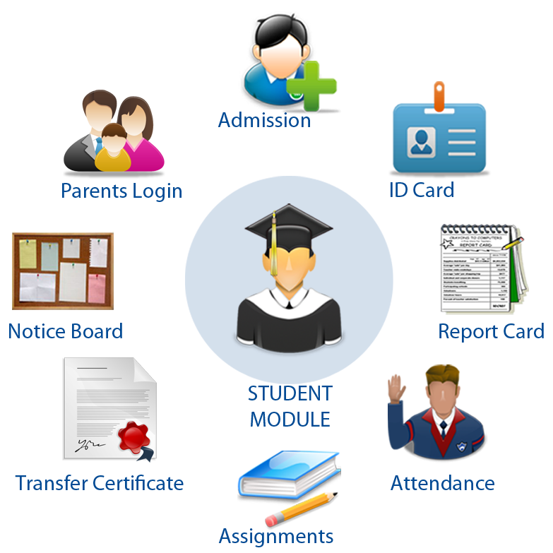
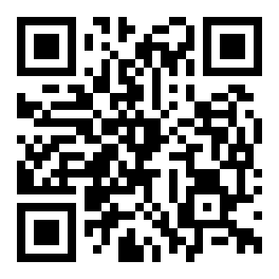
Core Modules - 1/4
Package Slides
< Previous
Next >

Slide 15
Core Modules - 2 /4
Hostel Management
GPS
Bus live Tracking
SMS Alert System
Fee management Online payment
Student & Staff -
Timetable attendance
& scheduling
Online examination & assignment
Package Slides
< Previous
Next >

Slide 16
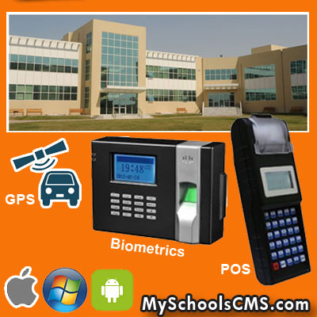
Core Modules - 3/4
Campus Automation
GPS – Bus Tracking
Biometric Solution - Staff and Student Attendance
Canteen, Library Billing
Package Slides
< Previous
Next >

Slide 17
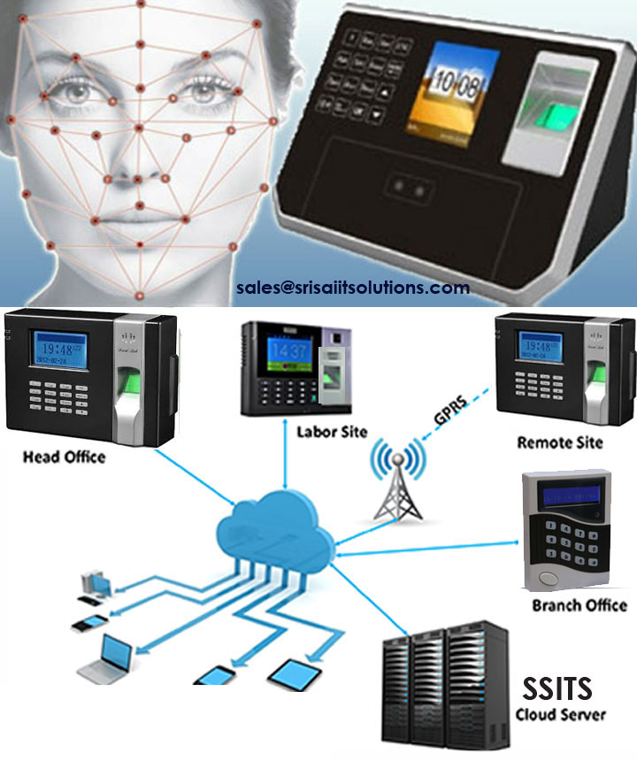
Biometric Solution - Staff and Student Attendance
Core Modules - 4/4
Package Slides
< Previous

Slide 18
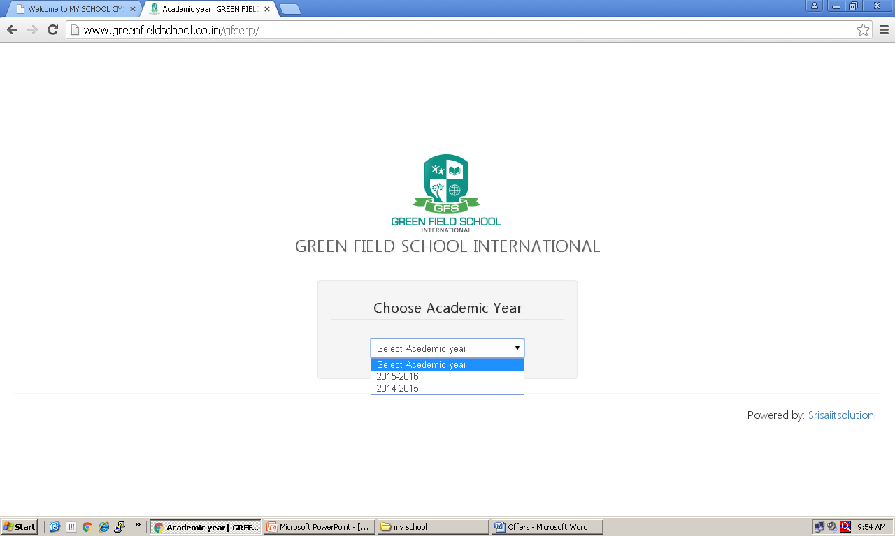
< Previous
Next >
Core Module

Slide 19
< Previous
Next >

Slide 20
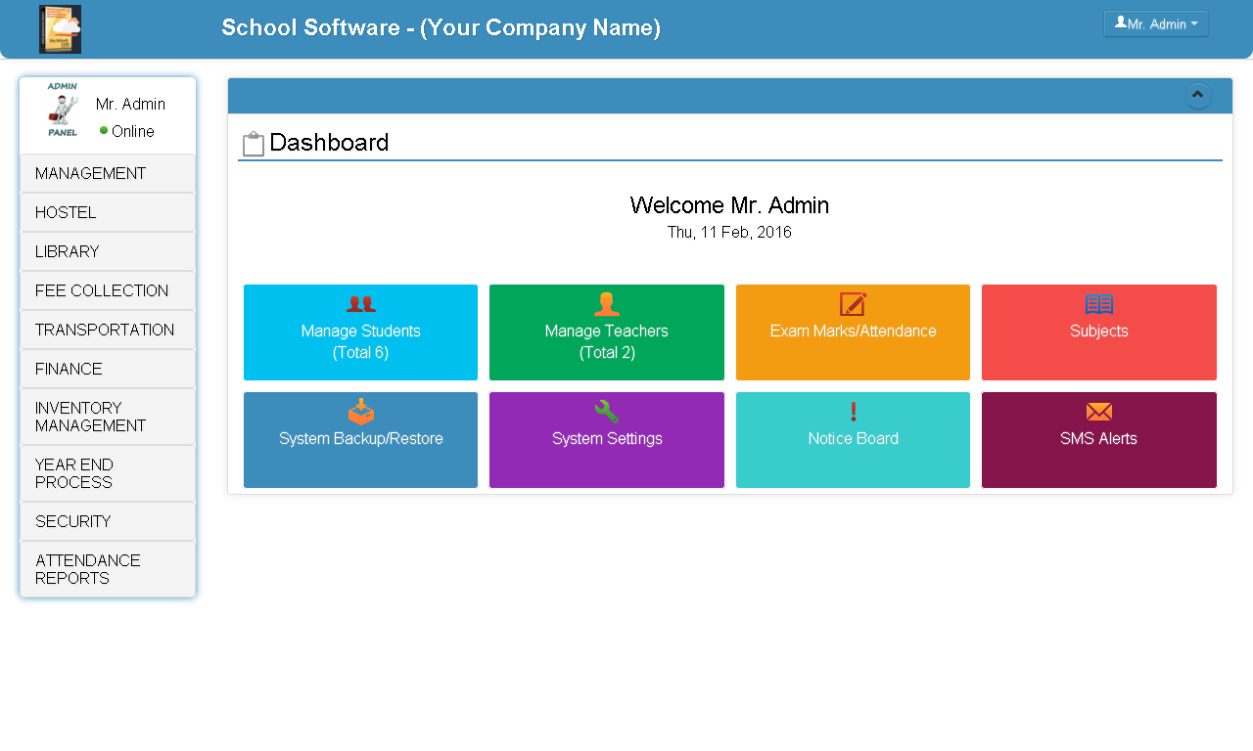
Admin - Dashboard
< Previous
Next >

Slide 21
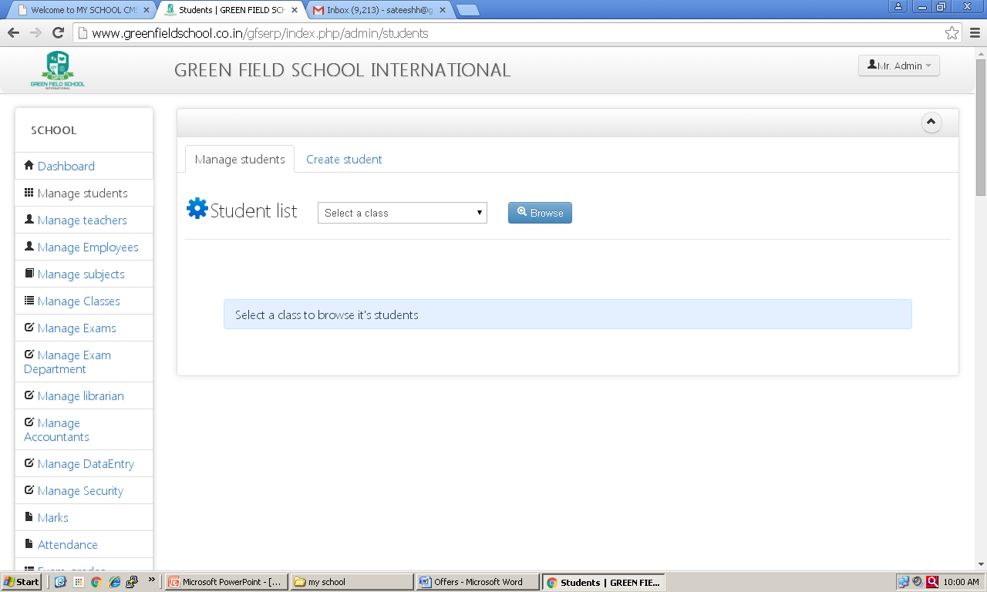
< Previous
Next >

Slide 22
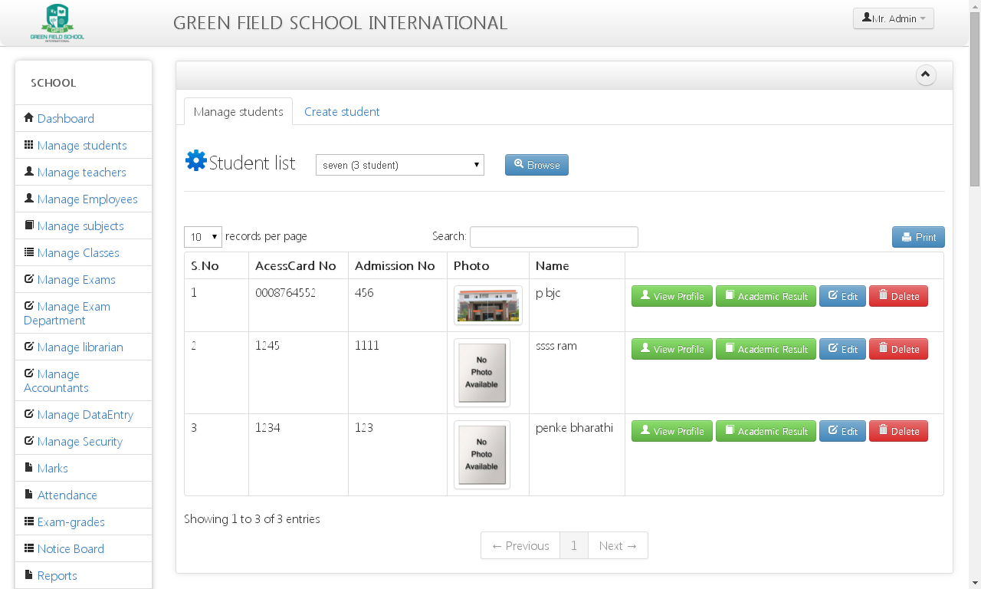
Student Profile and Academic Results
< Previous
Next >

Slide 23
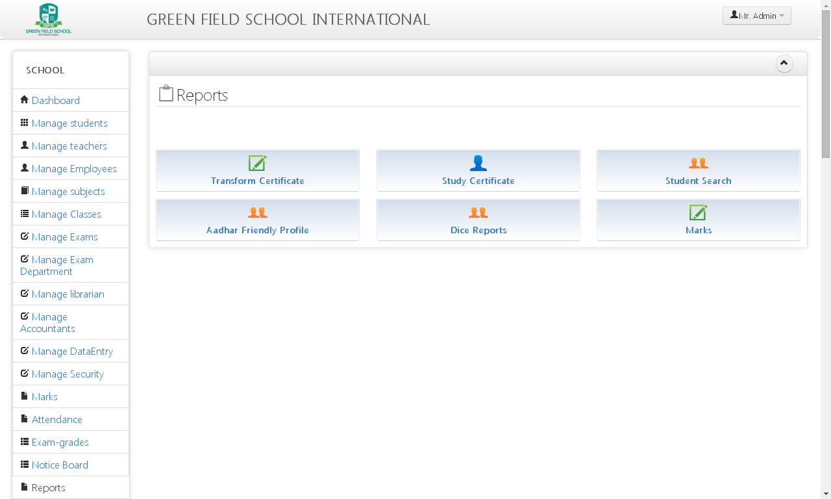
Reports - Students Report, Dise Report, Progress Report etc.
< Previous
Next >

Slide 24
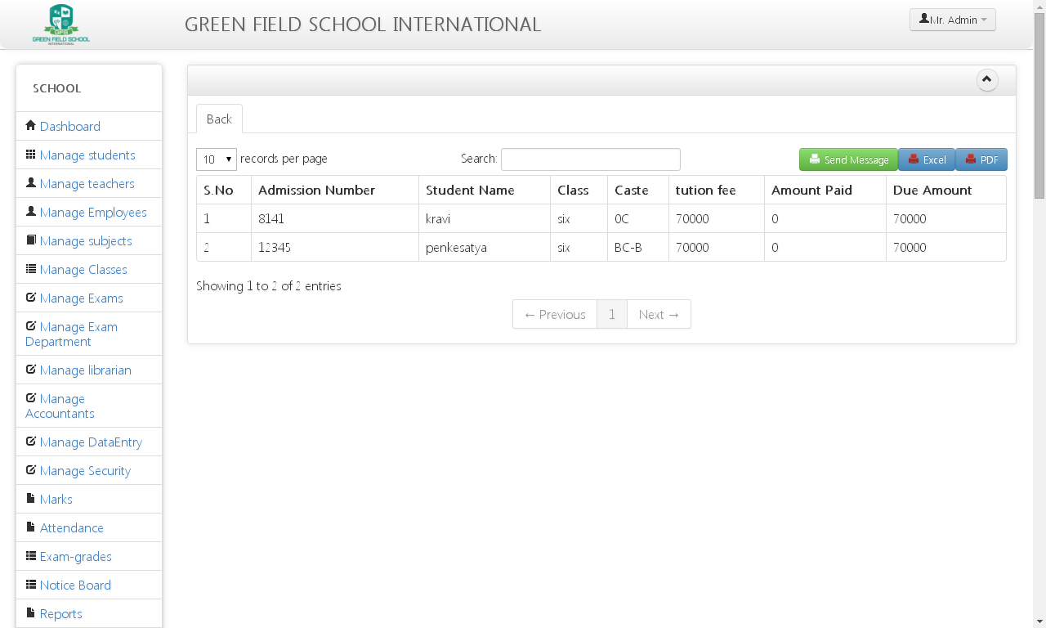
Fee Due List and SMS Alert Option
< Previous
Next >

Slide 25
For Above 1000 Student - License
(Student Data Bank, Library, Hostel,
Front Office, Store Inventory etc., )
1 Biometric Unit
1 GPS Unit
1 Lakh SMS
School Website
1 CMS - Domain (www.YourSchool.in)
20 Emails (principal@Yourschool.in)
Unlimited Photos
60 Days - Money Back
License: Per Student 25/- per month
< Previous
Next >
Enterprise Plan

Slide 26
For 300 to 500 Student - License
(Student Data Bank & Accounts.)
1 Biometric Unit - FREE
50 Thousand SMS - FREE
School Website - FREE
1 Domain (www.YourSchool.in)
5 Emails (principal@Yourschool.in)
Limited Photos
30 Days – Money Back
License: Per Student 15/- per month
< Previous
Next >
Standard & Popular Plan

Slide 27
Cloud APPLICATION:
Below 300 Students - License
Student Reports, SMS Module,
Fee Due Report, Staff Report
(Optional: Marks, Attendance, Store, Finance, Hostel, Gate Pass, Asset Tracking)
5,0000 - SMS - FREE
School Website - FREE
Domain (www.YourSchool.in) -FREE
5 Emails (principal@Yourschool.in)
Unlimited Photos
License: 25,000/- per annum
< Previous
Next >
Basic Plan

Slide 28
Thank You
Feedback
sateeshh@gmail.com
MySchoolsCMS Support
Help Line : 04040271894 (TN), 08842353570(AP)
+91 8341016646, +91 9030888277,
Skype : sateeshh_v
Live Chat Support Available
Working Hours (Mon - Sat 10 am to 6 pm)
Email : info@myschoolscms.com
sateeshh@gmail.com

